Slide 1
Injury Detection using UAV:
Optimizing Operations with Convolutional
Neural Networks
By: Abhishek Praveenkumar Muttath (W1649847)
Kushali Harish (W1652364)

Slide 2
Problem Description
Our project aims to detect injuries from videos/images captured from unmanned vehicles in areas of destruction.
Images captured from these vehicles are resized and injury/wounds are detected from these images.
Depending on the area of injury/wound calculated from the masked image produced by U-Net, we categorize level of injury.
Based on the level of injury predicted from the images captured in disaster zones, rescue teams can prepare well in advance with supplies required to treat wounded persons.
Our project aims to help rescue operations using image segmentation done by Convolutional Neural Networks.

Slide 3
U-net(A type of CNN)
U-Net developed in 2015 by Olaf Ronneberger and his team is an encoder-decoder CNN with extensive medical imaging, autonomous driving, and satellite imaging applications.
U-Net gets its name from its architecture. The “U” shaped model comprises convolutional layers and two networks. First is the encoder, which is followed by the decoder. The encoder network is also called the contracting network. This network learns a feature map of the input image.
This encoder network consists of 4 encoder blocks. Each block contains two convolutional layers with a kernel size of 3*3 and valid padding, followed by a Relu activation function. This is inputted to a max pooling layer with a kernel size of 2*2.
In between the encoder and decoder network, we have the bottleneck layer. This is the bottommost layer, as we can see in the model above. It consists of 2 convolutional layers followed by Relu. The output of the bottleneck is the final feature map representation.
The decoder network is also called the expansive network. It consists of 4 decoder blocks. Each block starts with a transpose convolution ( indicated as up-conv in the diagram) with a kernel size of 2*2. This output is concatenated with the corresponding skip layer connection from the encoder block. After which, two convolutional layers with a kernel size of 3*3 are used, followed by a Relu activation function.

Slide 4
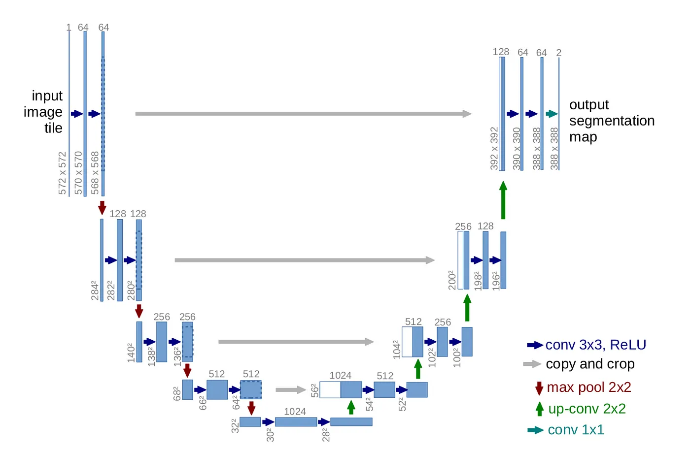
U-Net

Slide 5
Project Algorithm
Imported required libraries mainly Tensorflow, Keras and Numpy
Read and load images followed by preprocessing techniques like Normalization and resizing
Splitting preprocessed images and labelled images into training and validation sets
Training U-Net model with Conv2D and Max pooling methods with relu as our activation function in the encoder
The encoder progressively reduces the height and width of image but increases number of channels facilitating high-level feature extraction down the path
At the bottleneck layer, convolution is performed to generate a 30x30x1024 rich feature map
Expansive path then takes the feature map from the bottleneck and converts it back into an image of the same size as the original input. This is done using upsampling layers, which increase the spatial resolution of the feature map while reducing the number of channels.
Once model is trained, we preprocess test images in the same way as we did with train images.
We then use matplotlib to display the original test image and masked image generate by the U-net
We then calculate the area of the masked image where injury is detected to gauge level risk/medical attention required.

Slide 6
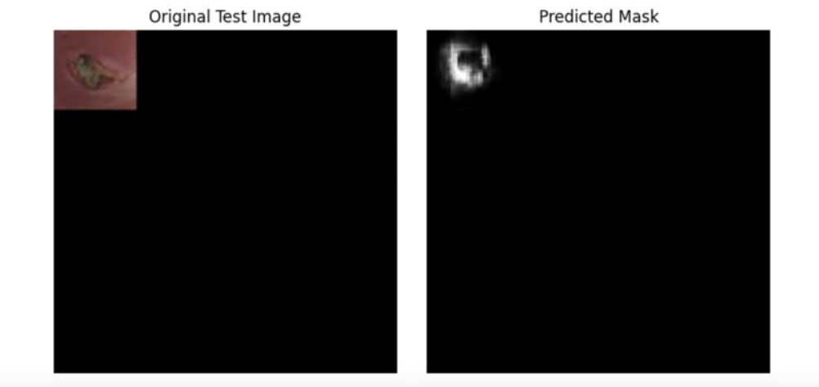
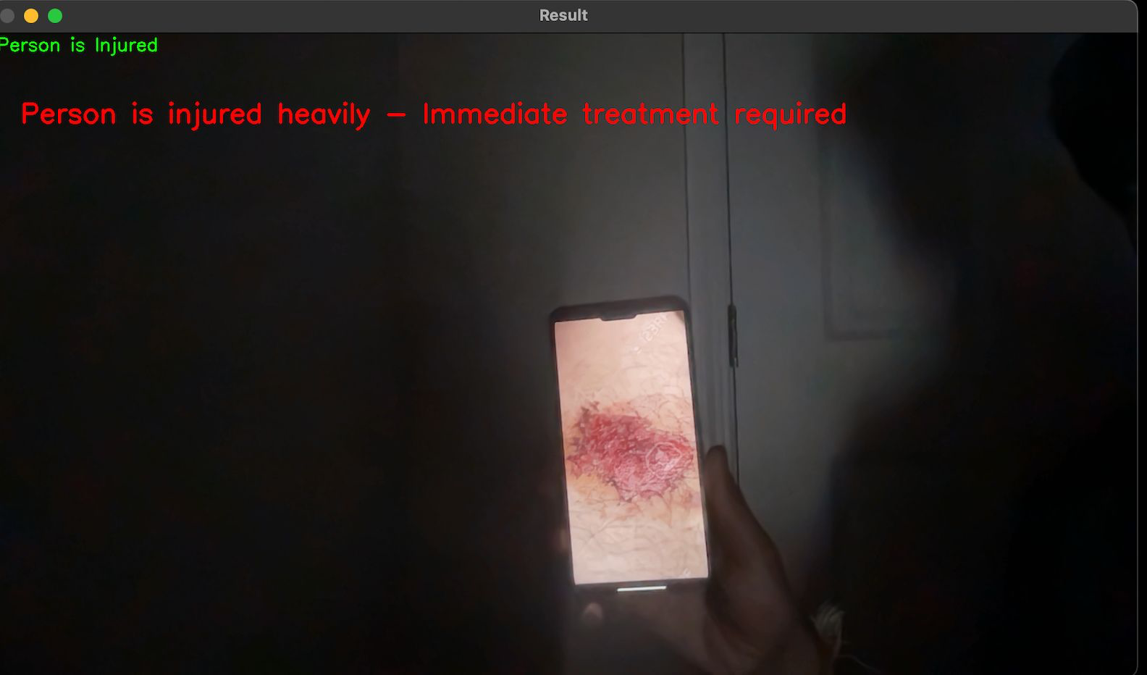
Result Analysis

Slide 7
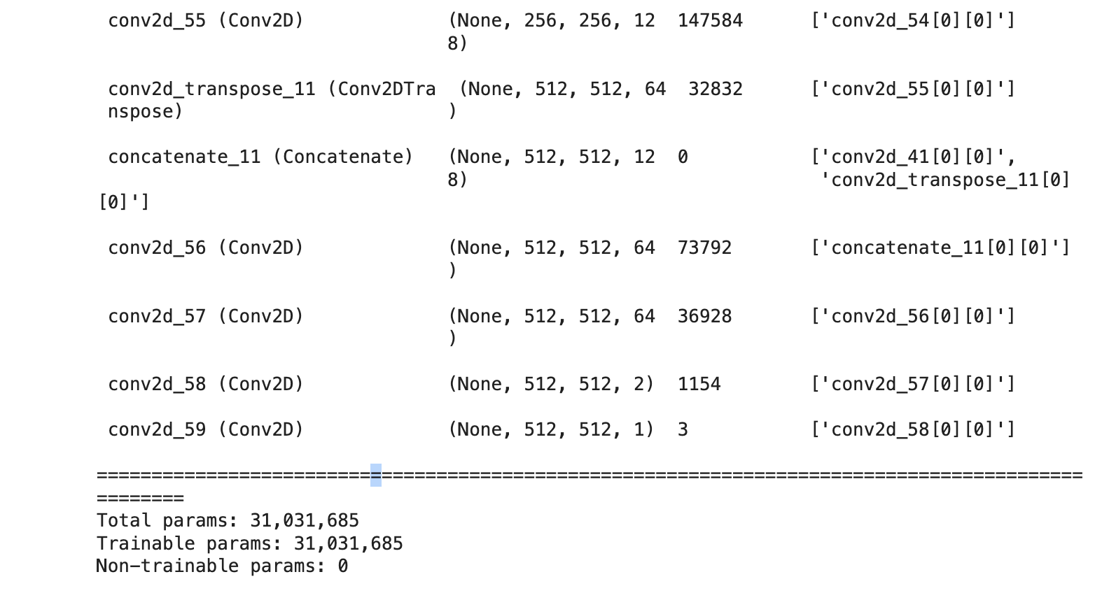
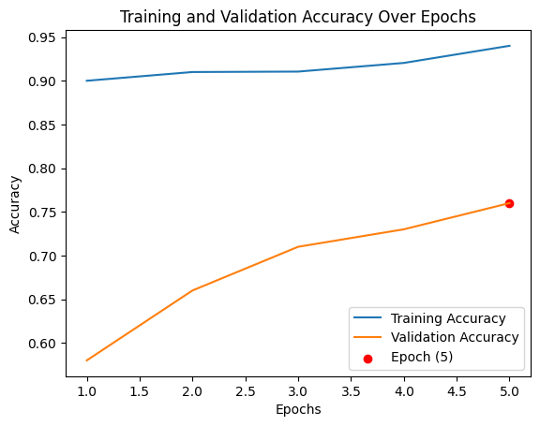
Results
The validation accuracy was 75%.
The model summary was as follows:

